Slide 1
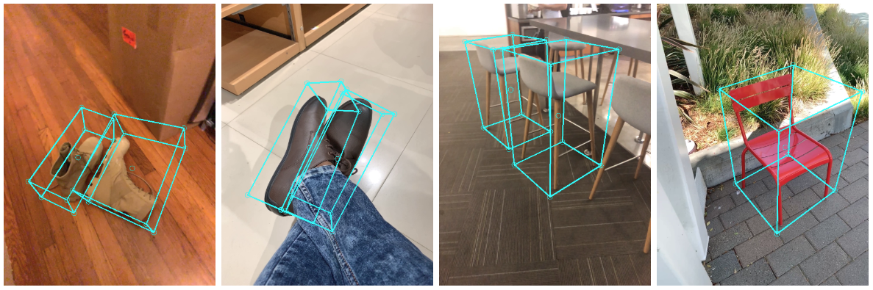
EEE 511 - ARTIFICIAL NEURAL COMPUTATION FINAL PROJECT PRESENTATION
Presented by:
Rikenkumar Patel - 1220689197
Darsh Shah - 1222859573
Devang Kakadiya - 1220410126
Md Ragib Shaharear - 1223383447
Robotics and Autonomous Systems
Professor: Jennie Si, Ph.D.
1

Slide 2

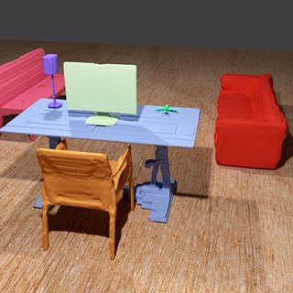

VOXEL-BASED OBJECT DETECTION AND 3D RECONSTRUCTION FROM SINGLE IMAGE
Github: https://github.com/Darshshah23/Voxel-based-3d-Detection-and-Reconstruction
Inspirational Papers Link: http://cvlab.cse.msu.edu/pdfs/MDR_paper.pdf
https://doi.org/10.48550/arXiv.2004.00452
Team 9: rpatel80, mshahare, dkakadiy, dshah58
2

Slide 3
PROBLEM STATEMENT
Motivation of this project
Problem Definition
3D locations and shapes of multiple objects from a single 2D image is a long-standing objective of computer vision.
Fundamental challenges for 3D detection and reconstruction.
Effectiveness of our approach to demonstrate in single object and multiple object scenarios.
Team 9: rpatel80, mshahare, dkakadiy, dshah58
3

Slide 4
INTRODUCTION
The goal is to create a framework that can infer all these 3D objects from a single 2D image.
This work is to achieve high-fidelity 3d reconstruction.
We present the YOLOV3 detector, which represent each objects in a partitioned 2D and 3D grid space by bounding boxes.
A new local Pixel Aligned Implicit Function (PIFu) function representation is proposed, which allows for finer reconstruction.
Proposed reconstruction method contains two key modules:
1. Pixel-Aligned Implicit Function
Multi-Level Pixel-Aligned Implicit Function
2 Front-to-Back Inference
Team 9: rpatel80, mshahare, dkakadiy, dshah58
4

Slide 5
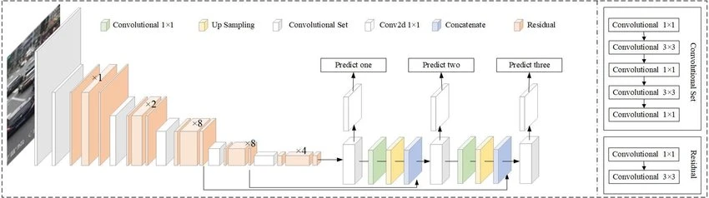
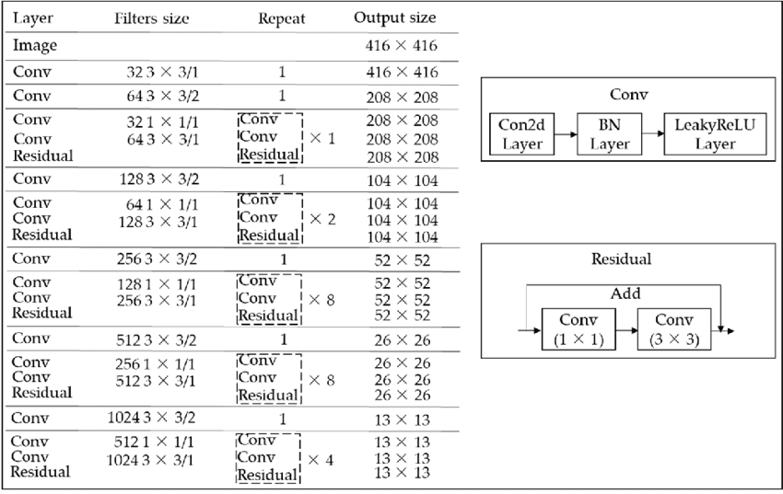
OBJECT DETECTION
Dataset:
COCO Dataset (80 Objects)
Object detection Method:
YOLOV3
Architecture:
53 Convolution Layer
Input Image Size: 416*416*3
Output is list of bounding boxes
System Requirement:
NVIDIA RTX 3060 system
Team 9: rpatel80, mshahare, dkakadiy, dshah58
5

Slide 6
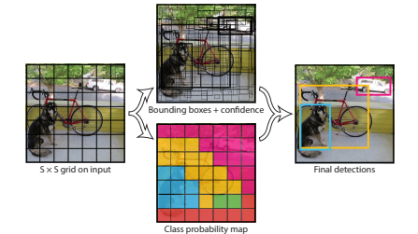
OBJECT DETECTION
Anchor Boxes:
YOLO v3 has three anchors. (three bounding boxes per cell)
Non-Maximum Suppression:
It only passes detection if they haven't already been detected.
Intersection over union (IOU):
Evaluation metric used to measure the accuracy of an object detector on a particular dataset.
Team 9: rpatel80, mshahare, dkakadiy, dshah58
6

Slide 7
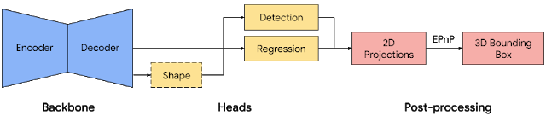
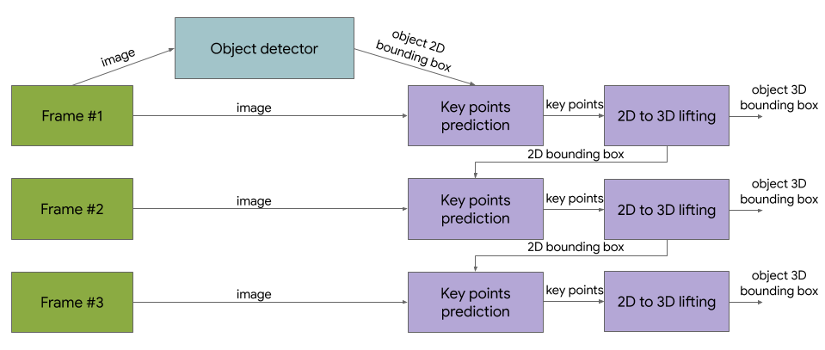
OBJECT DETECTION
MediaPipe Objectron:
Dataset:
Objectron (15000 annotated videos & 4M annotated images
Single-stage Pipeline
Encoder-Decoder architecture
Detection
Regression
Two-stage Pipeline
First stage: find 2D crop of the object
Second Stage: estimates 3D Bounding Box
Team 9: rpatel80, mshahare, dkakadiy, dshah58
7

Slide 8
3D OBJECT RECONSTRUCTION
3D Reconstruction:
Method - Pixel Aligned Implicit Function (PIFu):
Multi- Level Pixel-Aligned Implicit function
Front to Back Inference
Datasets:
RenderPeople data (500 subjects)
Training - 450 subjects
Test - 50 subjects
Input Image - 512 * 512
Batch size - 8
RMSProp
f(X; I) = 0 € R
Implicit function f(X,I) to predict the binary occupancy value . where X is the 3D position in continuous camera space and I is the single image.
f(X) = g^{L} Φ^{L} (x^{L}; I^{L}; F^{L}; B^{L}; ) ; Z
where I the is input and F(front) and B(back) are predicted normal maps at the same resolution. Φ is the image feature extractor , X is the projected 2d location.
Team 9: rpatel80, mshahare, dkakadiy, dshah58
8

Slide 9
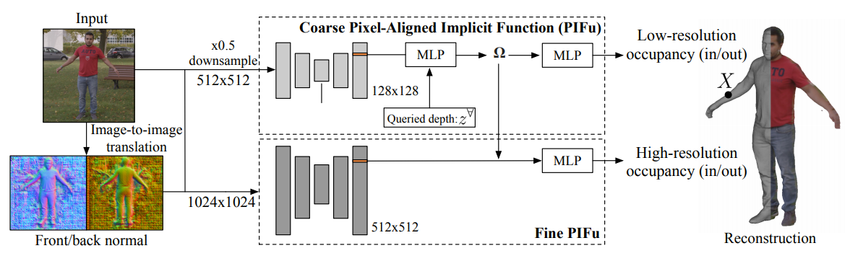
3D OBJECT RECONSTRUCTION
Two levels of pixel-aligned predictors produce 3D reconstruction:
Coarse level capture global 3D structure
A fine level that focuses on adding more subtle details.
Team 9: rpatel80, mshahare, dkakadiy, dshah58
9

Slide 10
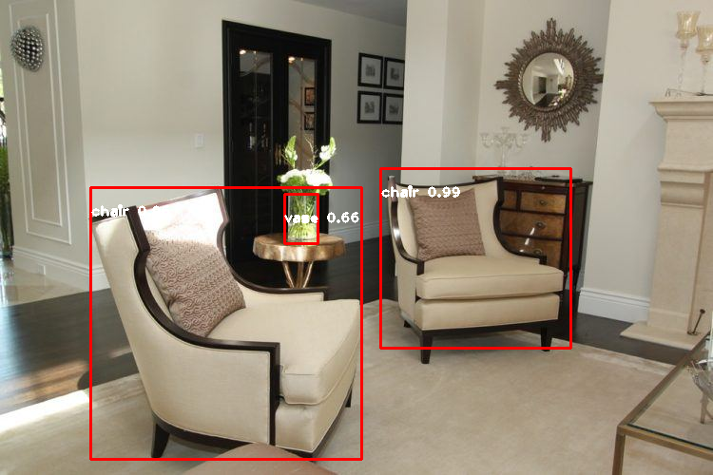
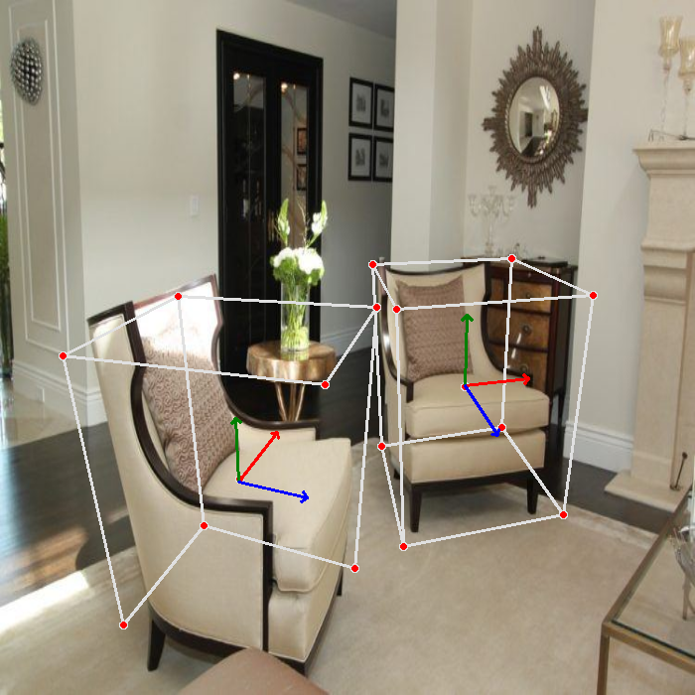
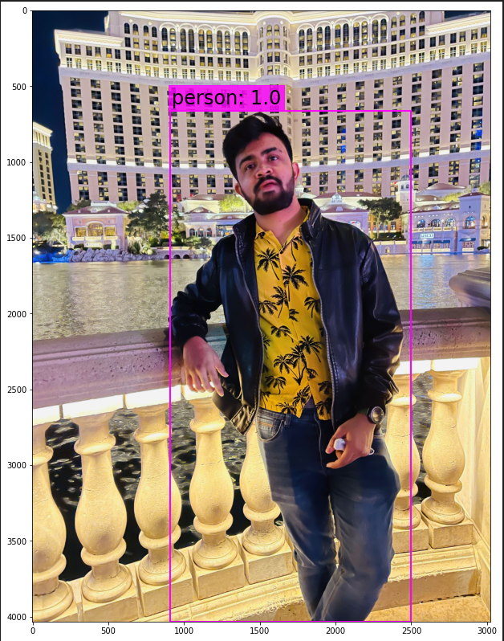
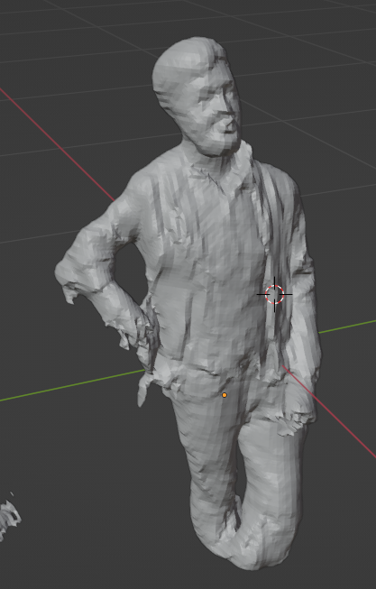

OUTCOME SUMMARY
Detecting the objects from image:
Taken some pictures from our surroundings and also from internet.
We tested images for both 2D and 3D bounding boxes.
Also tested the neural networks for live video stream to check the detection accuracy.
3D Reconstructing the detected object:
Worked on the neural network to take an image, remove background and segment the object and then make a 3D model of the object in ‘blender’.
Team 9: rpatel80, mshahare, dkakadiy, dshah58
10

Slide 11

OUTCOME SUMMARY
Experiment results for detection:
YOLOv3 with 2D and Mediapipe with 3D bounding boxes gives better prediction than our previously worked, CenterNet3D and mobileNetSSD models.
Also considering Live stream object detection with average 21 FPS gives above 87.3% accuracy.
Experiment results for 3D reconstruction:
we have almost over 76% confidence (accuracy) for 3D reconstruct the objects detected that we represent the model into ‘blender’.
Team 9: rpatel80, mshahare, dkakadiy, dshah58
11

Slide 12


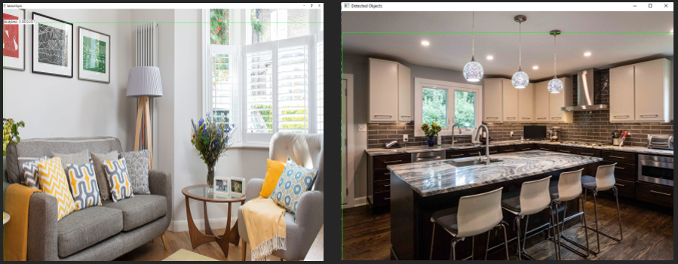
CHALLENGES AND SOLUTIONS
Problem: Incomplete information on initial Code:
Solution: completed it but not desired output.
Different neural network model.
Problem: Less Label categories to detect(19):
Solution : Changed dataset from ScanNetMDR
to COCO and Objectron.
Problem: 3D reconstruction of multiple objects:
Solution: Image segmentation of all individual objects(remove.bg).
Converting point cloud to model with RGB depth image(depth estimation).
Also for time constraint, we focused on the human images.
Team 9: rpatel80, mshahare, dkakadiy, dshah58
12

Slide 13
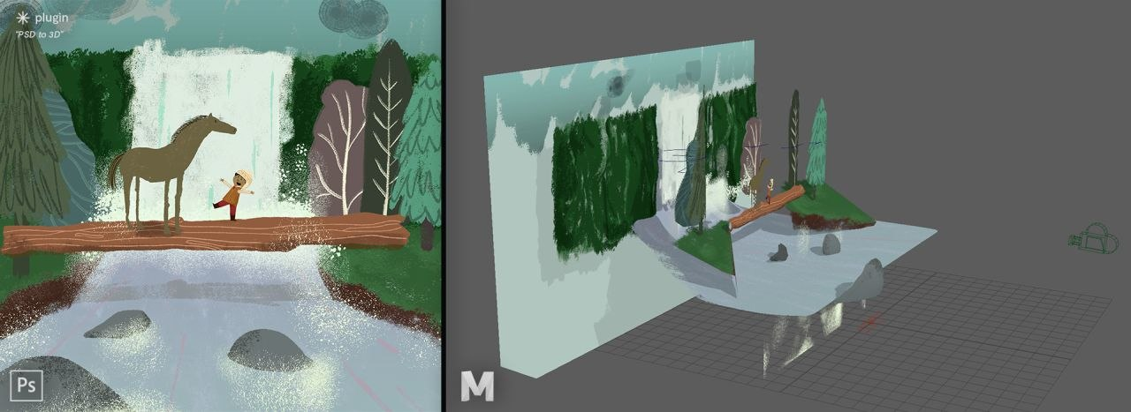
FUTURE WORKS
As this is very interesting concept for object detection, reconstructing the model individually from point cloud(we are considered in recent work) worked better for 3d objects.
In future of this project, we are considering the masking and segmenting the image and recreation a 3D image including whole environment.
Considering all objects from the image are there simultaneously rather that remodeling individually.
Team 9: rpatel80, mshahare, dkakadiy, dshah58
13

Slide 14
References
[1] Liu, Feng, and Xiaoming Liu. ”Voxel-based 3D Detection and Reconstruction of Multiple Objects from a Single Image.” Advances in Neural Information Processing Systems 34 (2021).
[2] Shunsuke Saito, Tomas Simon, Jason M. Saragih, Hanbyul Joo: PIFuHD: Multi-Level Pixel-Aligned Implicit Function for High-Resolution 3D Human Digitization. CoRR abs/2004.00452 (2020)
[3] Wei Liu, Dragomir Anguelov, Dumitru Erhan, Christian Szegedy, Scott E. Reed, Cheng-Yang Fu, Alexander C. Berg:SSD: Single Shot MultiBox Detector. CoRR abs/1512.02325 (2015)
[4] Y.C. Chiu, C.Y. Tsai, M.D. Ruan, G.Y. Shen and T.T. Lee, ”Mobilenet- SSDv2: An Improved Object Detection Model for Embedded Systems,” 2020 International Conference on System Science and Engineering
[5] Joseph Redmon, Ali Farhadi:YOLO9000: Better, Faster, Stronger. CoRR abs/1612.08242 (2016))
[6] Christopher B. Choy, Danfei Xu, JunYoung Gwak, Kevin Chen, Silvio Savarese: 3D-R2N2: A Unified Approach for Single and Multi-view 3D Object Reconstruction. CoRR abs/1604.00449 (2016)
Team 9: rpatel80, mshahare, dkakadiy, dshah58
14

Slide 15


15

